Slide 1
Report Card 9
The children left behind
A league table of inequality in child
well-being in the world’s rich countries

Slide 2
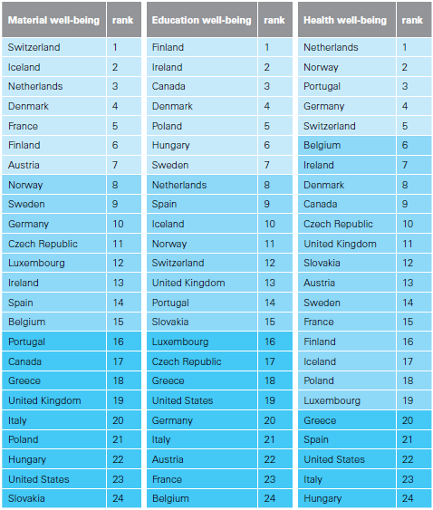
Fig.1a A league table of inequality in child well-being

Slide 3
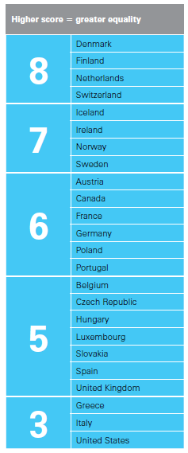
Fig.1b The overall record

Slide 4
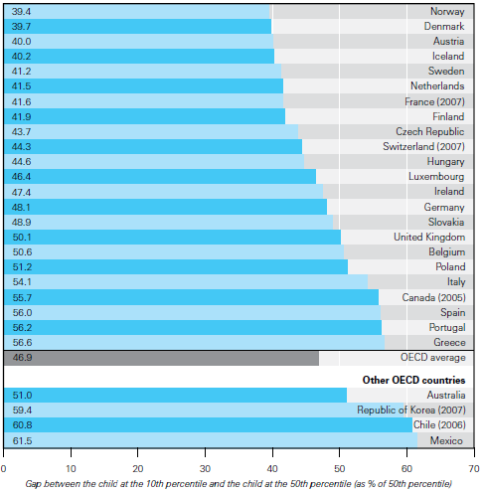
Fig.2a Inequality in material well-being: income

Slide 5
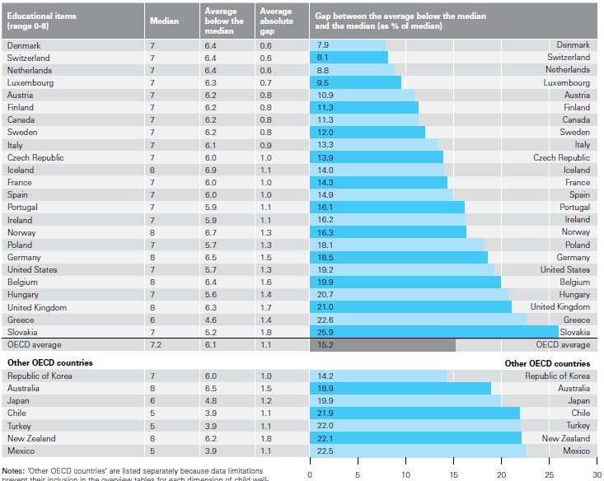
Fig.2b Inequality in material well-being: educational resources

Slide 6
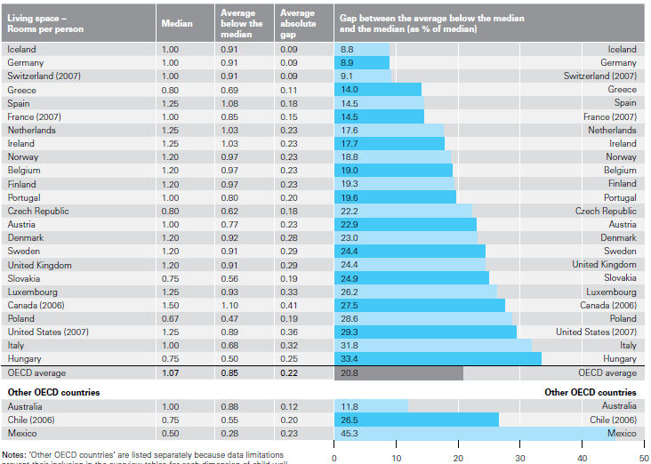
Fig.2c Inequality in material well-being: housing living space

Slide 7
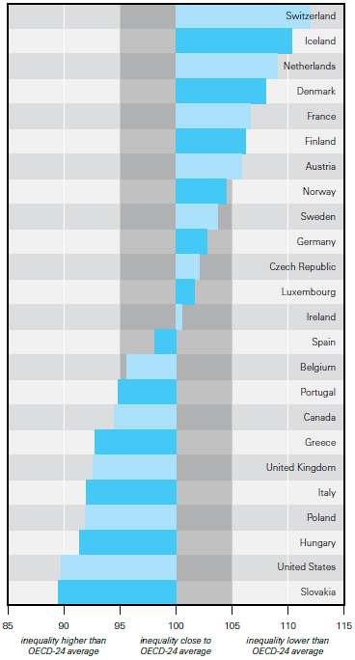
Fig.2d Inequality in material well-being: an overview

Slide 8
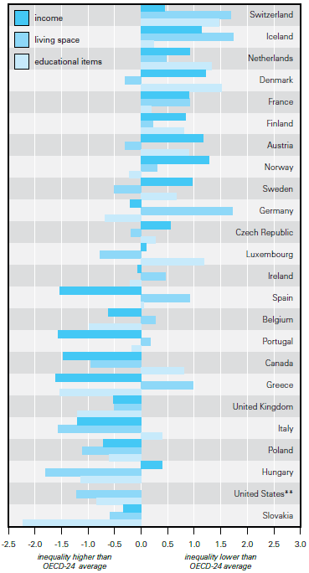
Fig.2e Inequality in material well-being: a breakdown

Slide 9
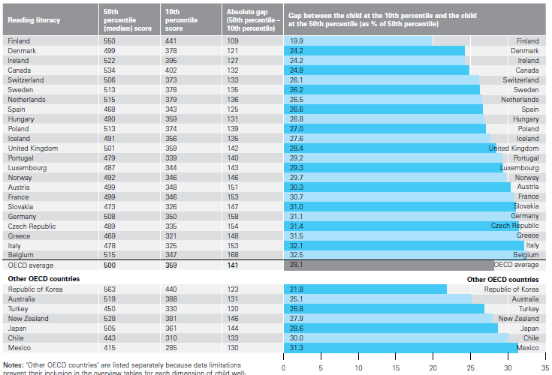
Fig.3a Inequality in reading literacy

Slide 10
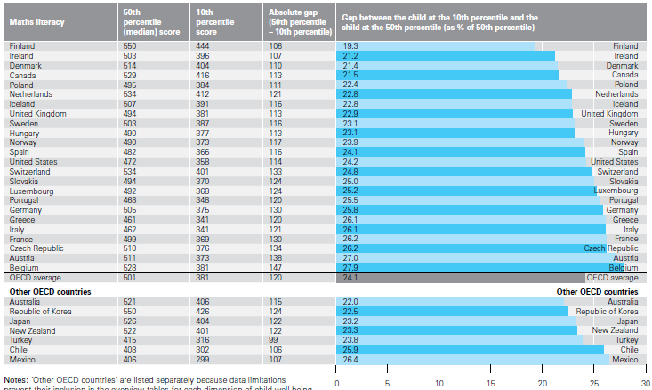
Fig.3b Inequality in maths literacy

Slide 11
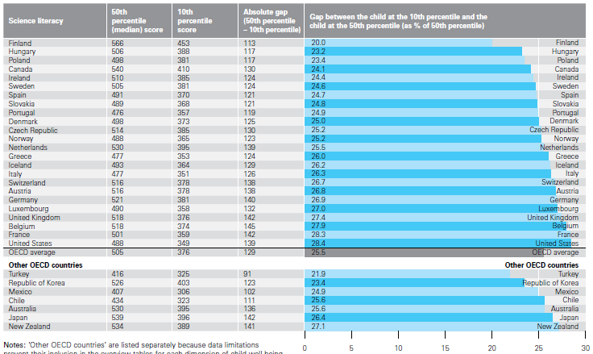
Fig.3c Inequality in science literacy

Slide 12
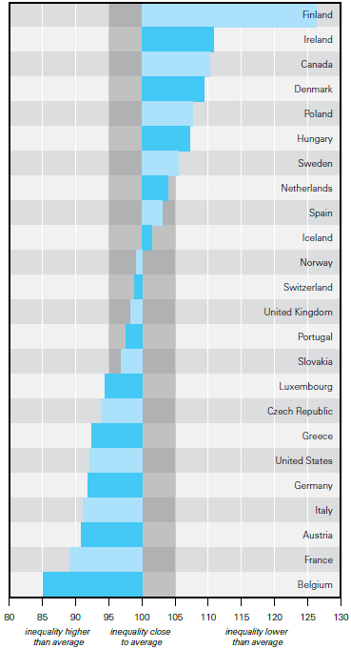
Fig.3d Educational inequality: an overview

Slide 13
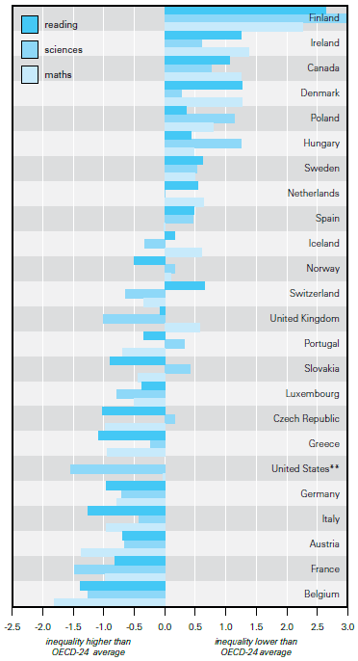
Fig.3e Educational inequality: a breakdown

Slide 14
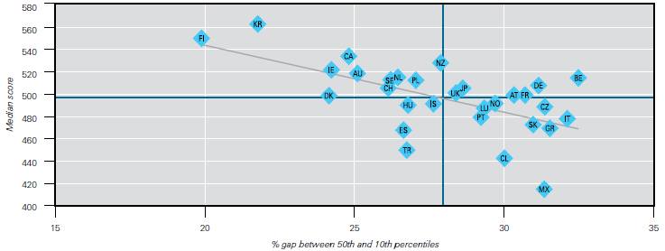
Fig.3f(i) Bottom-end inequality and median achievement

Slide 15
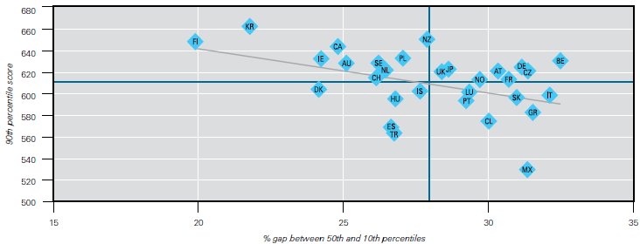
Fig.3f(ii) Bottom-end inequality and top-end achievement

Slide 16
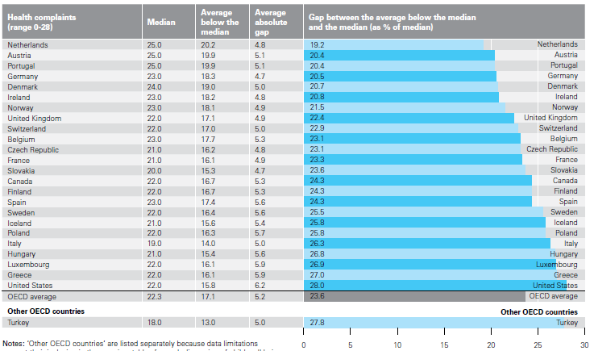
Fig.4a Health inequality: self-reported health complaints

Slide 17
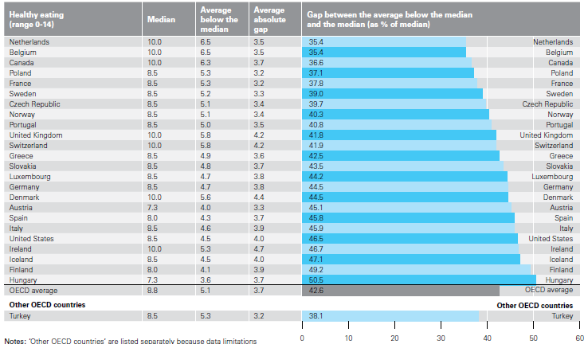
Fig.4b Health inequality: health eating

Slide 18
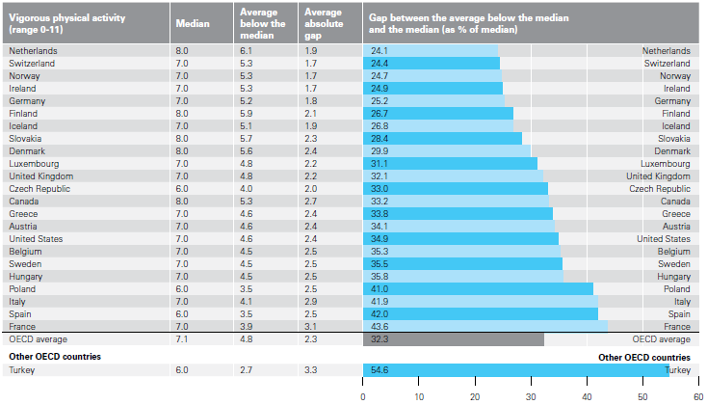
Fig.4c Health inequality: vigorous and physical activities

Slide 19
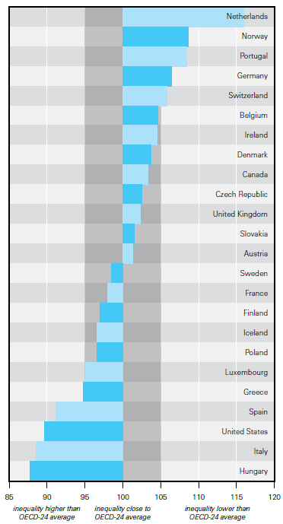
Fig.4d Health inequality: an overview

Slide 20
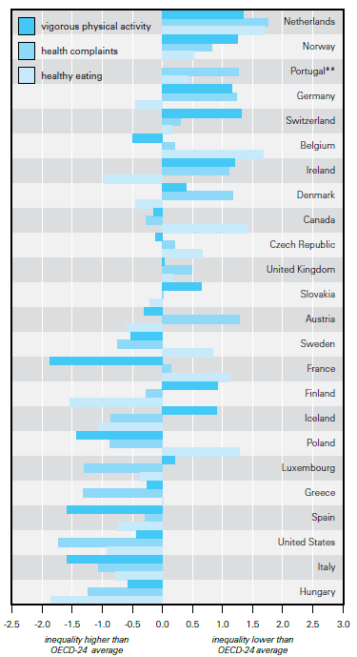
Fig.4e Health inequality: a breakdown

Slide 21
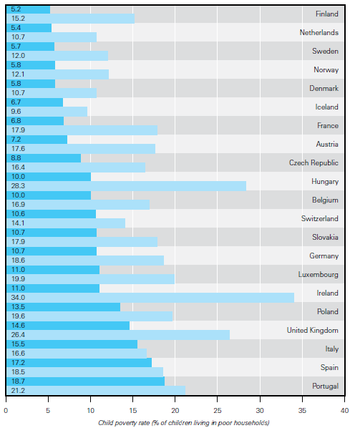
Fig.5a Markets, governments, and child poverty rates

Slide 22
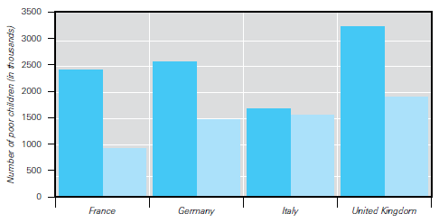
Fig.5b Child poverty and public spending on families

Slide 23
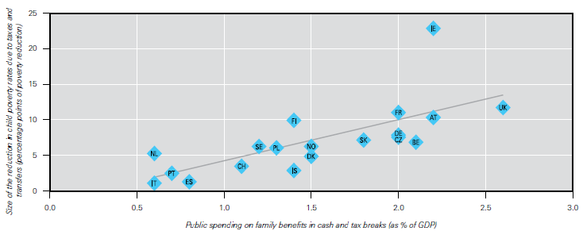
Fig.6a Reduction in child poverty rates by government family spending in cash benefits and tax allowances

Slide 24
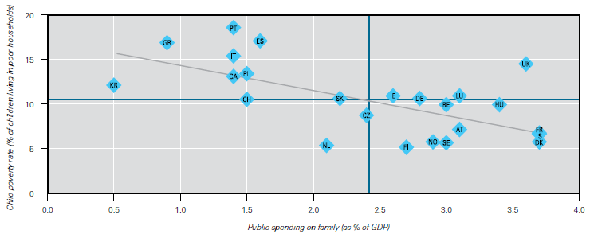
Fig.6b Child poverty rates and public spending on families

